Slide 1

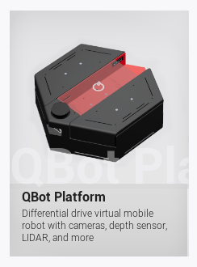
A CNN-Based Scene
Classification Framework
for Adaptive Line Following
on the Quanser QBot
ENG5337 Team Project Presentation
Group members:
Yunhao Huang, Nev Cohen, Xiaowei Xiao,
Karthik Mandigiri , Tao Bai, Yaocheng Wan,
Sheng Ruan
Student IDs:
3132056H, 2365006C, 3092768X,
3155271M, 3163950B, 3117486W,
3149157R
ENG5337 Advanced Artificial Intelligence & Machine Learning 5
1
Notes:
Good morning everyone.
We are Group B, and today we will present our project, “A CNN-Based Scene Classification Framework for Adaptive Line Following on the Quanser QBot.”
Our project focuses on improving line following in the Quanser warehouse simulation.
The main idea is to combine visual scene classification with classical control so that the robot can respond more appropriately to different road situations.
In the next few minutes, we will introduce our motivation, system design, implementation workflow, and final results.

Slide 2
Problem and Motivation
Task
Observed limitations of pure PID
Our design decision
Robustly follow warehouse floor lines in the Quanser simulated environment.
Handle straight sections, corners, junction-related situations, and recovery cases.
Maintain stable closed-loop behaviour in real time.
Retain PID as the low-level controller for stable closed-loop execution.
Use CNN-based scene classification to improve scene understanding and mode selection.
Adapt controller gains and target speed based on the predicted scene type.
Keep the framework interpretable, lightweight, and suitable for deployment in Quanser.
Performs reasonably well on simple lines and many corners.
Struggles to handle junction-like situations reliably.
Often requires a conservative target speed to avoid leaving the line.
Has limited ability to adapt control behaviour based on scene type.
ENG5337 Advanced Artificial Intelligence & Machine Learning 5
2
Notes:
Our goal is to build a robust line-following system for the Quanser warehouse environment.
The robot needs to deal with straight sections, corners, junction-related situations, and recovery cases, while still maintaining stable real-time behaviour.
From our initial testing, we found that the tutorial PID controller performs well on simple lines, but becomes less reliable in more complex situations, especially around junctions.
It also tends to require a conservative speed setting to avoid leaving the line.
This motivated us to introduce better scene understanding, so that the controller can respond differently to different situations.

Slide 3
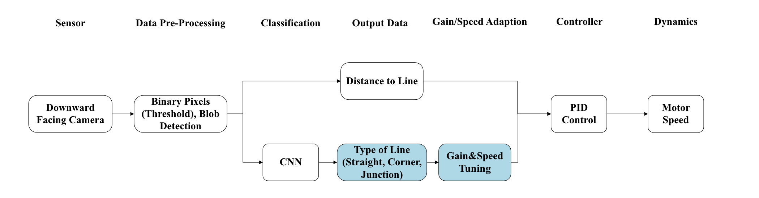
Final System Overview
Key point: the CNN is a scene classifier, not a direct end-to-end motor controller.
ENG5337 Advanced Artificial Intelligence & Machine Learning 5
3
Notes:
This slide shows the overall structure of our final system.
First, a downward-facing camera captures the floor line, and the image is preprocessed using thresholding and blob detection.
The processed image is then passed to a CNN, which identifies the current scene type, such as a straight path, a corner, or a junction.
This information, together with line-related measurements, is used to adjust the control settings.
The final motor command is then generated by the PID controller.
So overall, our system uses visual classification to improve decision-making, while PID remains responsible for stable execution.

Slide 4
Implementation Workflow
1
Collect data in Quanser
Xiaowei Xiao, Sheng Ruan
2
Train outside Quanser
Yunhao Huang, Karthik
3
Save the model file
Tao Bai
4
Load model back into Quanser
Nev Cohen
5
Iterate & Final Test
Yaocheng Wan, Xiaowei Xiao
ENG5337 Advanced Artificial Intelligence & Machine Learning 5
4
Notes:
Our implementation followed five main steps.
First, we collected labelled data in the Quanser warehouse environment.
Second, we trained and validated the model outside Quanser using Python and PyTorch.
Once the offline performance was acceptable, we exported the trained model.
Then, we loaded the model back into Quanser and connected its predictions to the live control loop.
If the line-following performance was still not satisfactory, we refined the data, preprocessing, or control mapping and repeated the process.

Slide 5


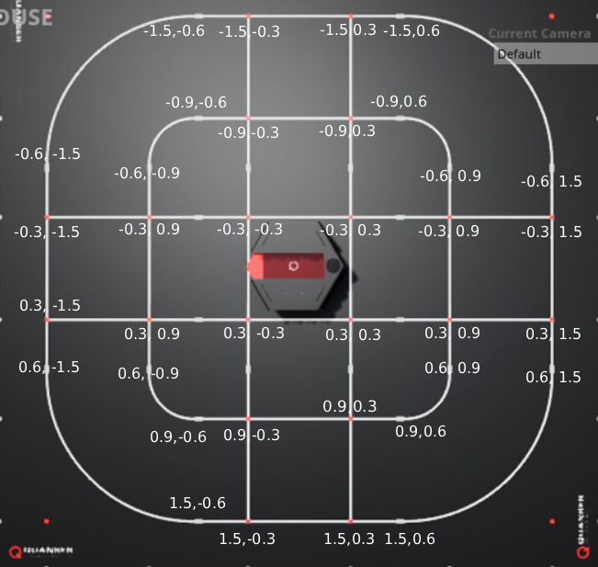
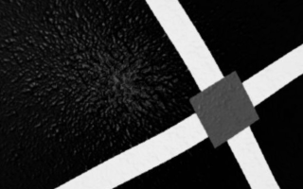


Data Selection and Labelling
Data collection method
PID & Manual
0 - Straight
Labelled dataset proportion using PID collect / manually collect
straight
4155
Data Labelling
1 - Curve
curve
781+578
crossroads
611+2386
2 – Crossroad
y
T-junction
1162
3 – T-junction
Off-route
2460
Total
8007+4126
9 – Out-route
x
ENG5337 Advanced Artificial Intelligence & Machine Learning 5
5
Notes:
For data collection, we initially used the PID controller to collect images automatically. However, this produced too few corner and crossroad samples. To address this issue, we manually drove the vehicle to capture additional images of corners and crossroads.
Because our dataset contained over 10,000 images, manual labelling would have been extremely time-consuming. Therefore, we chose to label the data automatically based on the robot’s coordinates.
For each image captured by the downward-facing camera, we simultaneously recorded the robot’s position on the map. In this way, every image was matched with a corresponding (x, y) coordinate pair.
We then divided the map into different regions and assigned labels according to the coordinate range of each image. Specifically, we used five labels:
0 for straight line,
1 for corners,
2 for crossroads, and
9 for off-track cases, where the robot was too far away from the white line.

Slide 6
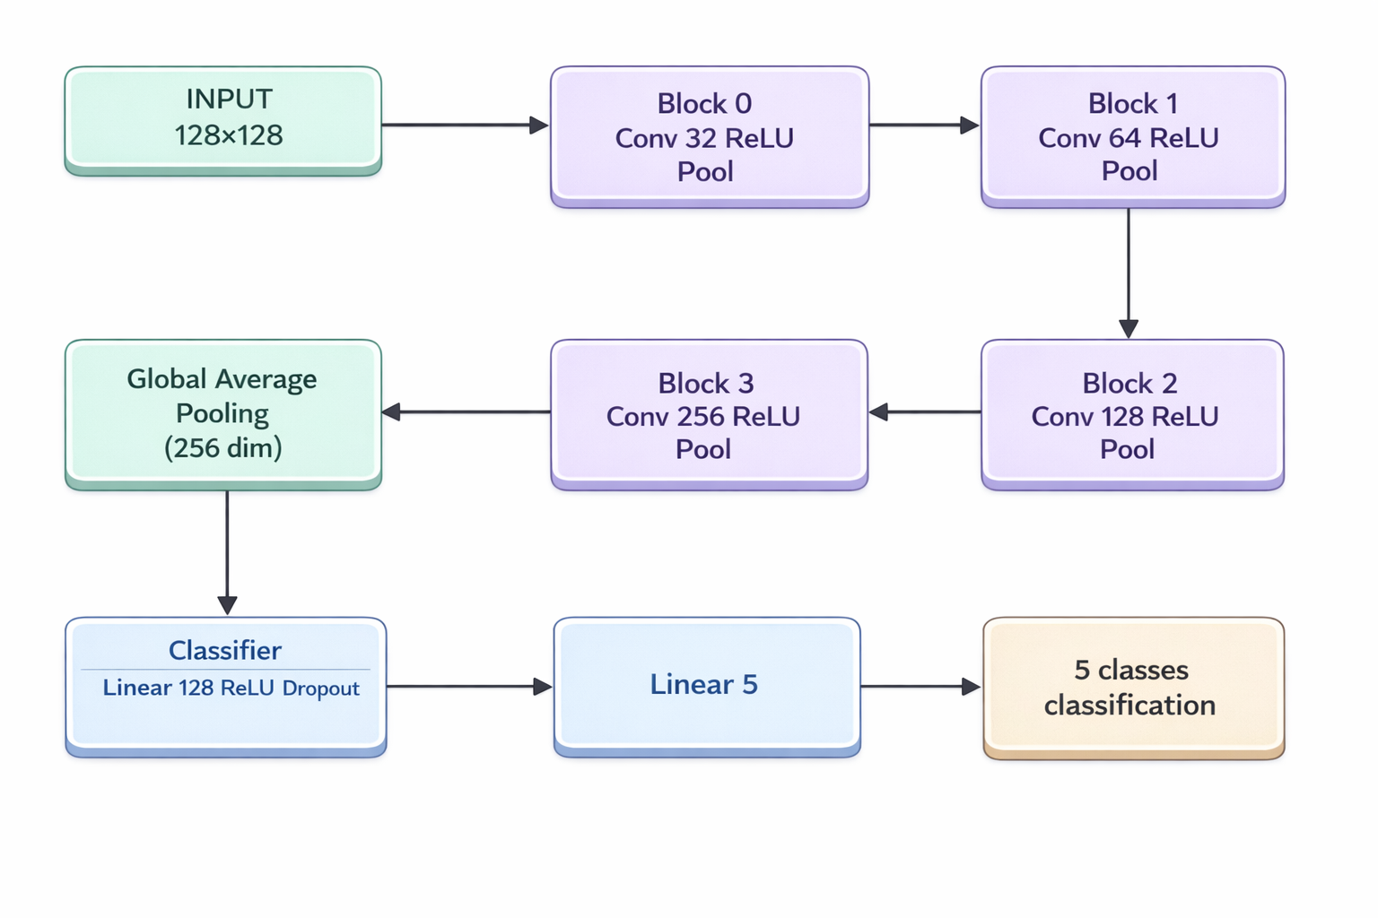
CNN Model Design
Task definition
Task: 5-class scene classification
Classes: crossroad, curve, out-route, straight, T-junction
Input: 128×128 Gray scale
Output: 5 scene classes
Parameters: ~420K
Role: scene classifier for adaptive control
Why this model
Lightweight baseline architecture
Suitable for efficient training and deployment
ENG5337 Advanced Artificial Intelligence & Machine Learning 5
6
Notes:
This slide presents the design of our baseline CNN model.
The task of this model is 5-class scene classification, where the input is a 128 by 128 RGB image from the downward-facing camera, and the output is one of five scene classes: crossroad, curve, out-route, straight, or T-junction.
The architecture is intentionally lightweight.
It uses four convolutional blocks for feature extraction, followed by global average pooling and a small classifier head.
Overall, the model has around 420 thousand parameters, which makes it suitable for efficient training and later deployment.
A key point here is that this CNN is not used as a direct motor controller.
Instead, it acts as a scene classifier for adaptive control, and its predictions are later used to adjust PID gains and target speed.
So, we chose this model because it provides a good balance between simplicity, efficiency, and practical usability in our Quanser framework.

Slide 7
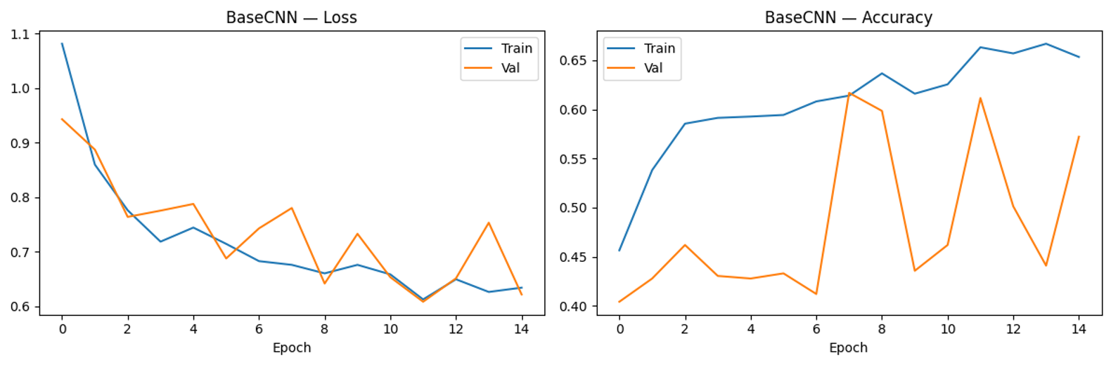
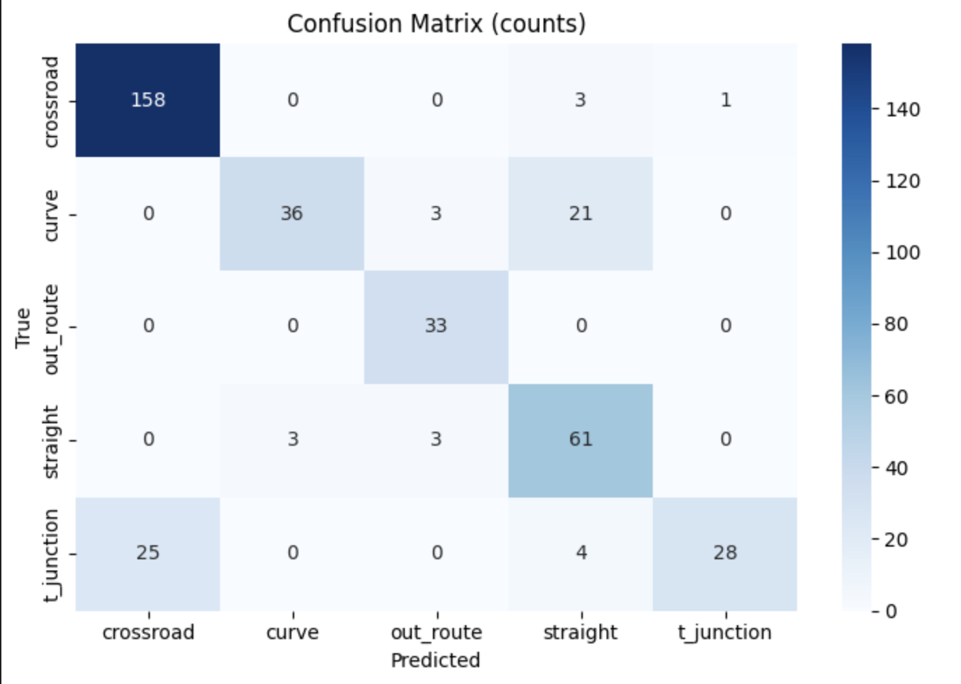
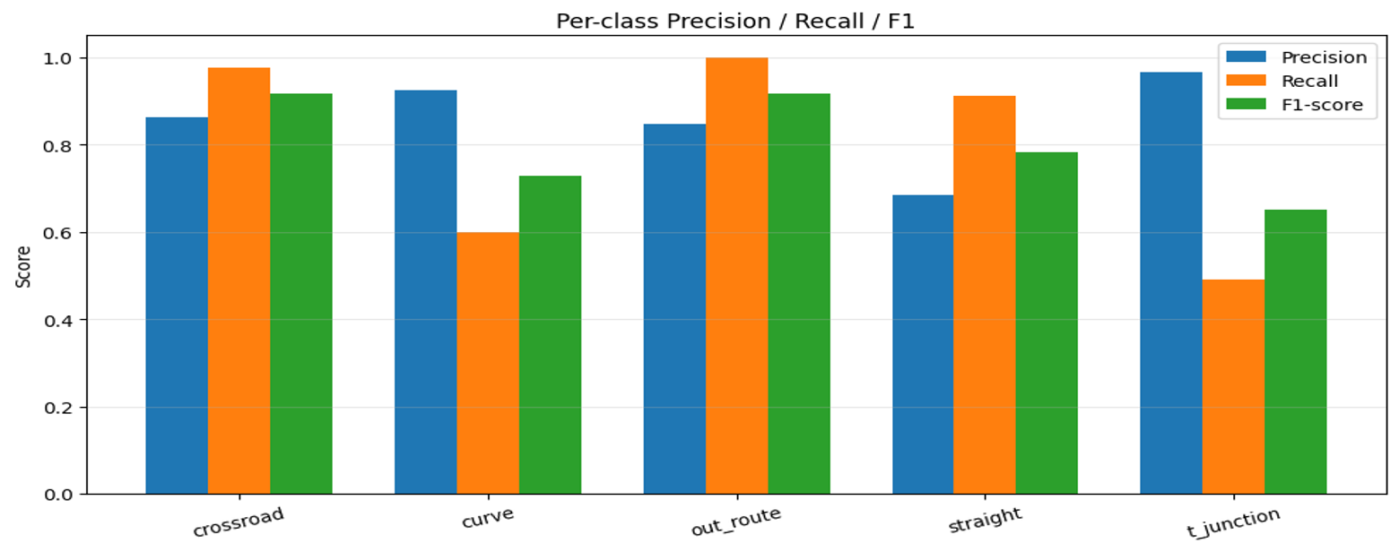
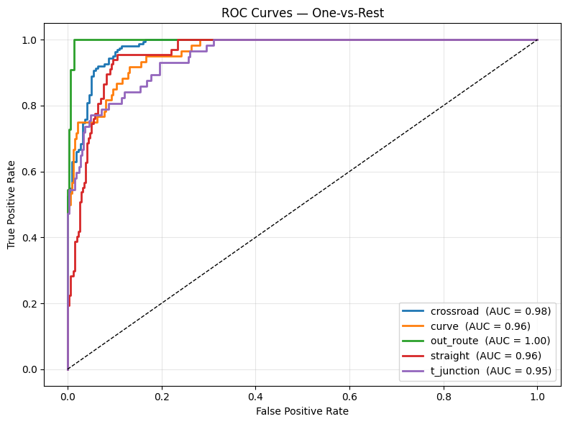
CNN Model Design
ENG5337 Advanced Artificial Intelligence & Machine Learning 5
7
Notes:
This slide shows our CNN model design and its classification performance.
From the loss and accuracy curves, we can see that the model trains steadily and reaches a validation accuracy of around 80 percent.
This suggests that the model has learned useful visual patterns from the dataset.
The confusion matrix shows that some classes are easier to recognise than others.
In particular, curve and T-junction are more difficult, which is likely due to the limited field of view of the downward-facing camera.
The precision, recall, F1-score, and ROC curves further confirm that the classifier performs well overall.
So the main takeaway is that the CNN can reliably recognise scene types, and this supports our adaptive control strategy in the overall system.

Slide 8
Adaptive Control Logic
Predicted class
Meaning
Controller mode
Target speed
Expected behaviour
0
Straight
PID-A
high
fast stable tracking
1
Curve
PID-B + Speed Damping
medium / low
slower turning
2
Crossroad
FSM
low
active stop, then turn
3
T-junction
FSM
low
active stop, then turn
9
Off-route
recovery
very low
re-acquire line
This slide is the project core: CNN provides mode selection; PID still performs low-level control.
ENG5337 Advanced Artificial Intelligence & Machine Learning 5
8

Slide 9


Coding progress
1. CNN Development Pipeline:
(1)Data Preparation
Check label quality
Handle class imbalance
Data imbalance handling :
Every class using same
picture numbers
Increase weight of minority classes
Data Accuracy checking:
This is off-route or straight?
This is straight or curve?
Collect additional samples
(2)Model Design & Training
Design CNN architecture
Match model complexity to dataset size
Train using labelled images
(3)Evaluation & Refinement
Compare model performance
Select the best CNN for control
Retrain with more data if needed
ENG5337 Advanced Artificial Intelligence & Machine Learning 5
9
Notes:
First, we developed the CNN in three stages: data preparation, model design, and performance evaluation.
We checked the dataset quality, handled data imbalance, and collected more samples where necessary. Also, we carried out data accuracy checking.
Then we designed a suitable CNN architecture and compared different models to select the one that was reliable enough for the final control task.

Slide 10
Coding progress
2.CNN Deployment in the Line-Following Controller
The selected CNN was integrated into line_following.py to classify road scenarios during driving.
Camera image → CNN prediction → Control decision
Challenge 1: Output instability
High-frequency CNN output may cause oscillation
Occasional wrong predictions can disturb steering
Solution: limit the update rate / smooth the output
Challenge 2: Limited camera field of view
The downward-facing camera sees crossroads only briefly
At normal speed, PID reacts too late
Solution: trigger a special control logic at intersections
ENG5337 Advanced Artificial Intelligence & Machine Learning 5
10
Notes:
After that, we deployed the selected CNN into the line-following controller.
However, deployment introduced two practical challenges.
The first was output instability, where overly frequent CNN predictions could make the vehicle shake.
The second was the limited field of view of the downward-facing camera. At crossroads, the turning pattern is visible only for a very short time, so the PID controller may not react early enough.
This is why we later introduced a dedicated intersection-handling logic.

Slide 11
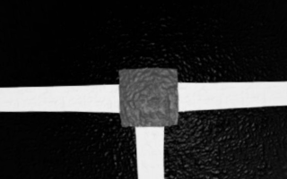
Coding progress
3.Final control strategy
Two possible methods
Operational Flow
Method 1: Predefined rule
CNN
STOP
DEC
TURN
GO
PID
Manually assign the next action
Detect junction
Set speed = 0
Choose feasible route
Turning 0 / ±90°
Move ahead briefly
Resume line tracking
e.g. always go straight / left / right
Simple, but inflexible
Method 2: Feasible-route detection
Detect white pixels in the left, front, and right regions
Identify which directions are available
More suitable for different T-junction layouts
ENG5337 Advanced Artificial Intelligence & Machine Learning 5
11
Notes:
The crossroad scenario is the most challenging part of the system.
When the CNN detects a crossroads or a T-junction, the robot first stops immediately. It then decides the next direction. Since no final goal is provided, this decision cannot rely on global planning.
For simple cases, the action can be predefined in code.
For T-junctions, we further use white-pixel detection on the left, upper, and right regions of the image to identify feasible routes, and then randomly select one of them.
The robot then performs the corresponding turn, with an angle of 0°, 90°, or -90°. After moving straight for a short distance, PID control is reactivated to continue normal path tracking.

Slide 12


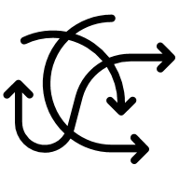

Benchmarking Setup
RMSE Error
Average Speed
No Line Instances
Corner Success Rate
ENG5337 Advanced Artificial Intelligence & Machine Learning 5
12
Notes:
All only scored while self-drive is engaged

Slide 13
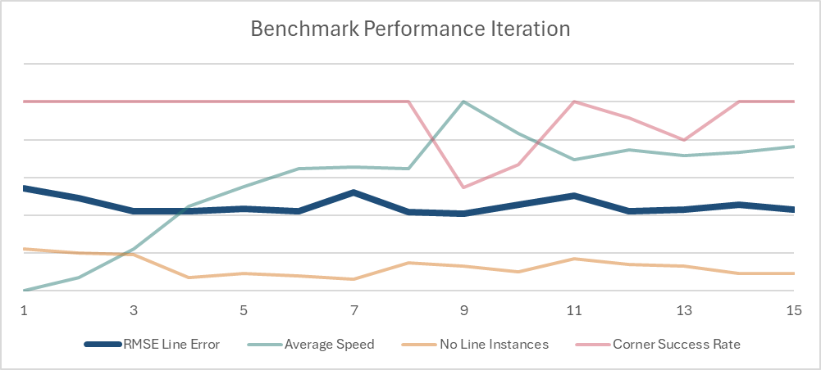
Tuning Performance Iteration
ENG5337 Advanced Artificial Intelligence & Machine Learning 5
13
Notes:
All only scored while self-drive is engaged

Slide 14
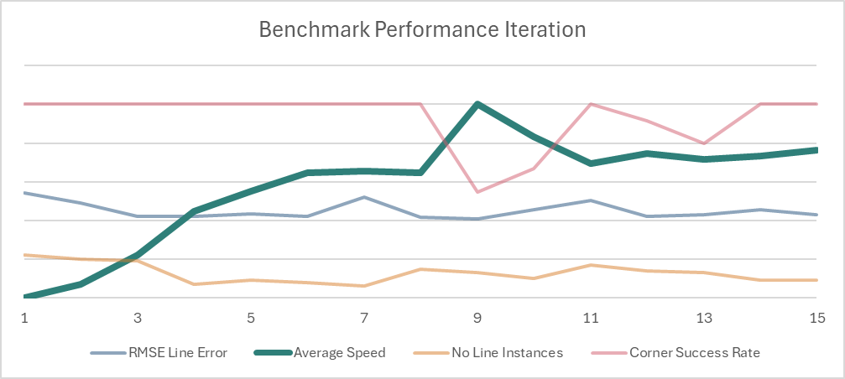
Tuning Performance Iteration
ENG5337 Advanced Artificial Intelligence & Machine Learning 5
14
Notes:
All only scored while self-drive is engaged

Slide 15
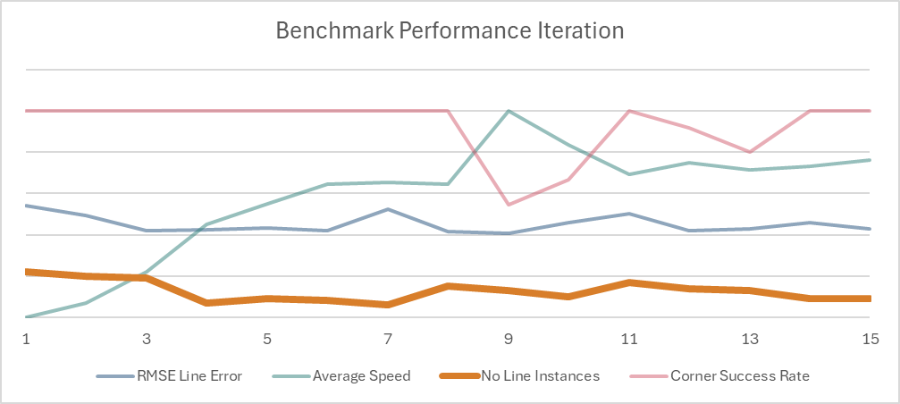
Tuning Performance Iteration
ENG5337 Advanced Artificial Intelligence & Machine Learning 5
15
Notes:
All only scored while self-drive is engaged

Slide 16
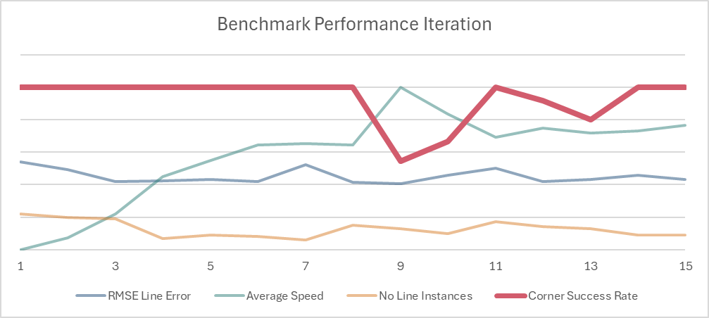
Tuning Performance Iteration
ENG5337 Advanced Artificial Intelligence & Machine Learning 5
16
Notes:
All only scored while self-drive is engaged

Slide 17
Results
Method | RMSE Line Error (Pixels) | Average Speed (cm/s) | No Line Instances (%) | Corner Success Rate (%)
PID Baseline | 162 | 12.9 | 9% | 33%
CNN + Adaptive PID | 172 | 12.3 | 9% | 100%
ENG5337 Advanced Artificial Intelligence & Machine Learning 5
17

Slide 18
Conclusion
What we achieved
Current limitations
Future improvements
The PID-based controller can follow straight paths reliably at low to moderate speed.
The CNN model is able to classify basic road patterns such as straight lines, curves, and intersections.
The combined system demonstrates the feasibility of using vision-based learning for line following in the Quanser environment.
The robot becomes unstable at higher speeds.
The system reacts too late to sharp curves and crossroads.
Turning behaviour still depends partly on fixed logic rather than adaptive decision-making.
The dataset is imbalanced and lacks sufficient samples for complex road structures.
Tune PID parameters for better high-speed stability.
Expand and rebalance the dataset, especially for curves and intersections.
Introduce finer labels for upcoming road structures.
Replace fixed turning rules with a learned decision module.
Use CNN predictions to adjust both speed and steering earlier.
ENG5337 Advanced Artificial Intelligence & Machine Learning 5
18
Notes:
Overall, our PID and CNN based system shows that vision-based line following is feasible in the Quanser environment.
The PID controller can follow straight paths reliably at low to moderate speeds, and the CNN model can classify basic road types such as straight paths, curves, and intersections.
However, the system still has some limitations.
The robot becomes unstable at higher speeds, reacts too late to sharp curves and crossroads, and still relies partly on fixed turning logic.
In the future, we plan to tune the PID controller, improve and rebalance the dataset, and use CNN predictions to make earlier and more adaptive speed and steering decisions.

